Slide 1
Chapter 3 Verbal Communication Keimyung University
3.1 Language and Meaning
Language is Symbolic
We combine symbols to give us language systems or codes
These codes help us organize, understand and generate meaning
Symbolic nature of Human communication = Displacement - calculate

Slide 2
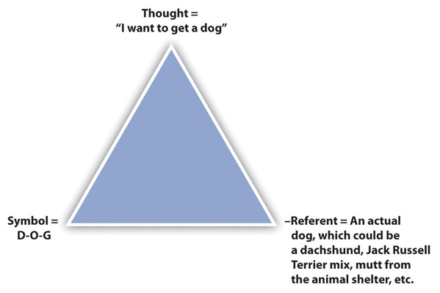
Chapter 3 Verbal Communication Keimyung University
The Triangle of Meaning
A model of communication
We need Clarification!

Slide 3
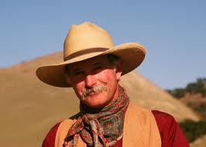
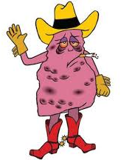
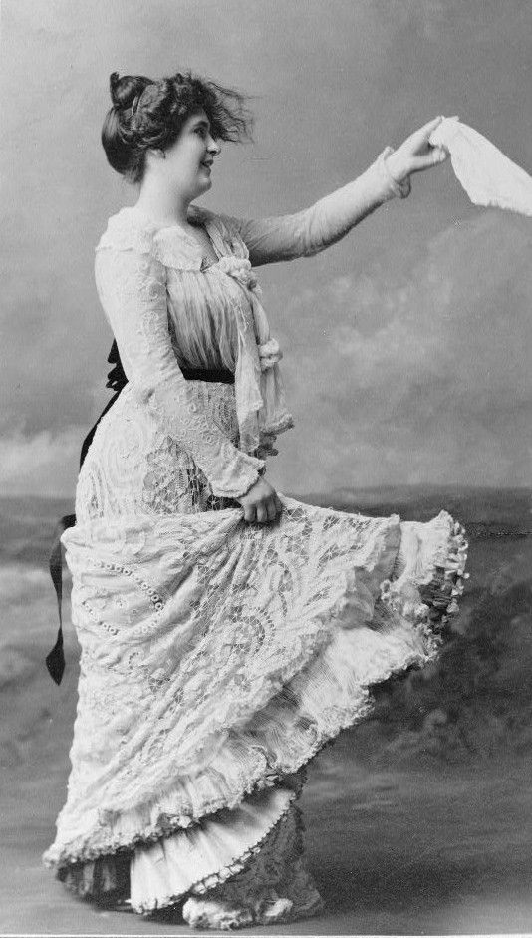
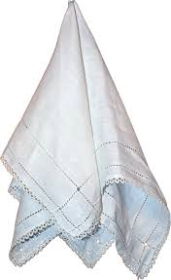
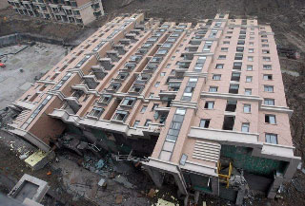
Chapter 3 Verbal Communication Keimyung University
Definitions
Denotation & Connotation
- monosemic / polysemic words
Cowboy - poylsemic |  | Handkerchief - monosemic
Denotation | Connotation | Denotation | Connotation

Slide 4
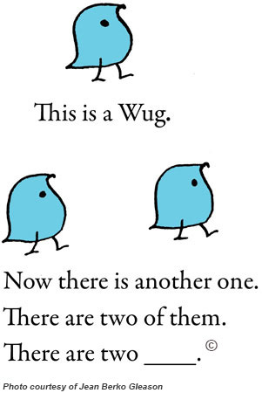
Chapter 3 Verbal Communication Keimyung University
Language Acquisition
If you have time, please watch this fantastic video –
BBC Horizon 1983 A Child's Guide To Languages
https://www.youtube.com/watch?v=utDs2tI14IQ

Slide 5
Chapter 3 Verbal Communication Keimyung University
Exercises
1. | Trace the history of a word (its etymology) like we did with calculate earlier in the chapter. Discuss how the meaning of the word (the symbol) has changed as it has gotten further from its original meaning. Two interesting words to trace are hazard and phony.
2. | Apply the triangle of meaning to a recent message exchange you had in which differing referents led to misunderstanding. What could you have done to help prevent or correct the misunderstanding?
3. | Think of some words that have strong connotations for you. How does your connotation differ from the denotation? How might your connotation differ from another person’s?

Slide 6
Chapter 3 Verbal Communication Keimyung University
3.2 Functions of Language
Language is:
Expressive
- observations, thoughts, feelings, and needs
Powerful
identities, affects our credibility, serves as a
means of control, and performs actions
http://www.dailymotion.com/video/x1y1ez7_tony-abbott-last-week-tonight_news
Fun
- Palindromes / Contranyms…word play
https://www.youtube.com/watch?v=kAG39jKi0lI
Dynamic
Neologisms / #blacklivesmatter, because, Google
Slang / Inversion, Reduction, Creativity / da bomb, tight
Relational
initiate, maintain, and terminate our
interpersonal relationships.

Slide 7
Chapter 3 Verbal Communication Keimyung University
3.2 Functions of Language
Relational
Supportive Messages | Unsupportive Messages
I You We Our Us | 1. Global labels. 2. Sarcasm. 3. Dragging up the past. 4. Negative comparisons. 5. Judgmental “you” messages. 6. Threats.
Exercise
1. Review the types of unsupportive messages discussed above. Which of them do you think has the potential to separate people the most? Why? Which one do you have the most difficulty avoiding (directing toward others)? Why?

Slide 8
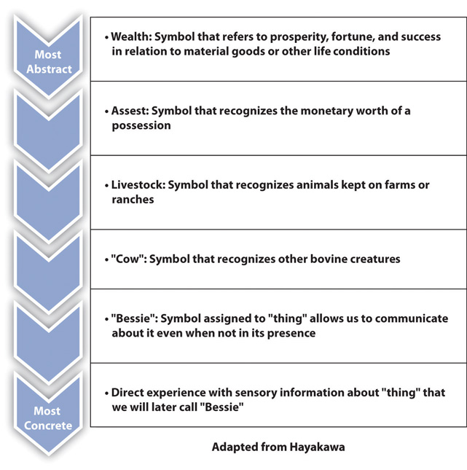
Chapter 3 Verbal Communication Keimyung University
3.3 Using Words Well
Levels of Abstraction
Following the example in the ladder of abstraction, take a common word referring to an object (like bicycle or smartphone) and write its meaning, in your own words, at each step from most concrete to most abstract. Discuss how the meaning changes as the word/idea becomes more abstract and how the word becomes more difficult to define.

Slide 9
Chapter 3 Verbal Communication Keimyung University
3.3 Using Words Well
Partial Messages
“I don’t trust Bob anymore.”
Contaminated Messages
“It looks like you wasted another semester.”
Whole Messages
“Your dad and I talked, and he said you told him you failed your sociology class and are thinking about changing your major” (observation). “I think you’re hurting your chances of graduating on time and getting started on your career” (thought). “I feel anxious because we both took out loans to pay for your education” (feeling). “Would you be willing to talk about it with me?” (need).
Decontaminate the following messages by rewriting them in a way that makes them whole (separate out each type of relevant expression). You can fill in details if needed to make your expressions more meaningful. (In pairs)
“I feel like you can’t ever take me seriously.”
“It looks like you’ve ruined another perfectly good relationship.”
Jerry Springer
https://www.youtube.com/watch?v=Mb3Ag95h5_U

Slide 10
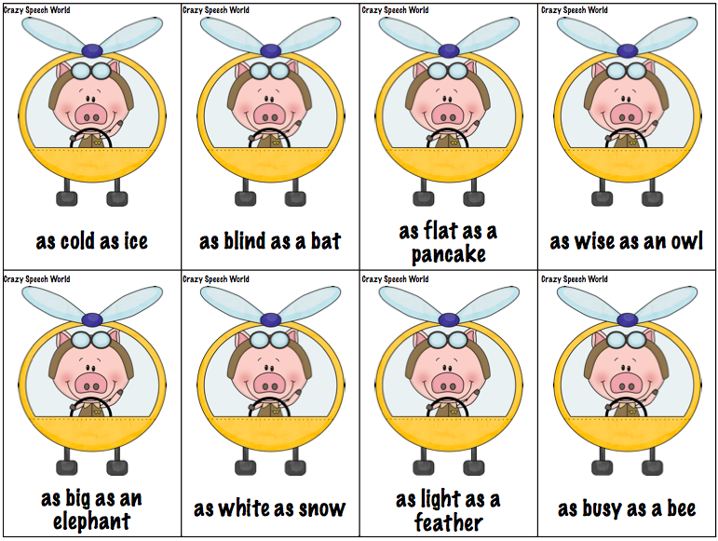
Chapter 3 Verbal Communication Keimyung University
3.3 Using Words Well
Using Words Affectively
Affective language
“Speak from the heart” - “I’m so happy!” - “Why me!?”
Figurative Language
Simile
Metaphor
Personification
Evocative Language
Find a famous speech (for example, at http://www.americanrhetoric.com) and identify components of figurative language. How do these elements add to the meaning of the speech?
Network: http://www.americanrhetoric.com/MovieSpeeches/moviespeechnetwork2.html
Youtube: https://www.youtube.com/watch?v=QcvjoWOwnn4
The Great Dictator:
http://www.americanrhetoric.com/MovieSpeeches/moviespeechthegreatdictator.html
Youtube: https://www.youtube.com/watch?v=dX25PDBb708

